Slide 1
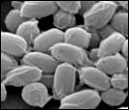
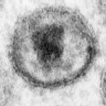
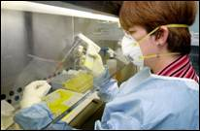
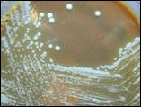
INFECTIOUS DISEASES

Slide 2
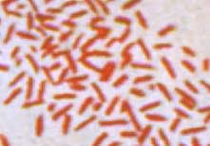
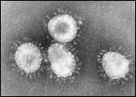
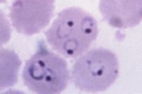
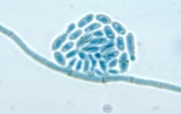

The four main groups of pathogens
Bacteria
Viruses
Protozoa/parasite
Fungi
Notes:
BLANK OUT out common disease they must write them down

Slide 3
Pathogen Type | Description | Where in the body | Disease example
Bacteria | Bacteria are simple, single-celled organisms. | Warm environments with moisture e.g. intestines, lungs and genitals | Pneumonia
Virus | Viruses are a non- living organisms that can’t survive without a host. | Somewhere they can invade quickly to take over your cells. e.g. respiratory system cells | The flu
Protozoa | Single-celled organisms. More complex than bacteria. | To live in and on many different parts of the body e.g. blood | Malaria
Parasite | Parasite are multicellular, motile organisms | To live in and on many different parts of the body. e.g. hair, intestines, brain | Intestinal worms
Fungi | Fungi absorb nutrients from their environment. Produce spores to reproduce. | Moisture and it must be present for it to grow e.g. feet, genitals | Athlete’s foot

Slide 4
GROSS IMAGE AHEAD

Slide 5

Robin Cochran-Dirksen (Many slides from BioEdOnline Baylor Christine Herrmann PhD)

Slide 6
HOSTS
Notes:
Definitive and intermediate

Slide 7
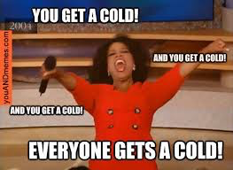
HOSTS
RESERVOIR:
VECTOR:
INCIDENTAL HOST:
The long-term host of the pathogen.
Do not get the disease.
Living host that has the pathogen and can transmit it.
Carriers: are vectors that don’t show symptoms but can still transmit the disease.
Host that has the pathogen but rarely transmits it.

Slide 8
EXAMPLE: WEST NILE VIRUS
Reservoir:
Vector:
Incidental host:
Signs/Symptoms:
-Fever
-Headache
-Joint pains
Treatment:
    -pain relivers
    -Intravenous fluids

Slide 9
ACTIVITY- in pairs research and create a Padlet.
Choose one person to create a Padlet account.

Slide 10
ACTIVITY- in pairs research and create a Padlet.
Choose one person to create a Padlet account.
Click create Padlet.
2nd person access the Padlet by using the url.

Slide 11
ACTIVITY- in pairs research and create a Padlet.
PICK ONE:
-ross river virus
-influenza
-food poisoning
-tinea
-malaria

Slide 12
You must:
1. what type of pathogen causes the disease
2. scientific name
3. Name the reservoir (long term host) vector (organism that passes it on), incidental hosts (rarely pass it on)
4. Describe how it is transmitted
5. List 3 signs/symptoms
6. List 2 treatments

Slide 13
Connect – Submissions
- Submit the link to your Padlet (in a word doc or screen capture) or the downloaded version
Make sure your names are on the poster

Slide 14
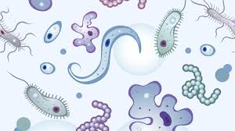
INFECTIOUS DISEASES - DEFINITIONS
Infectious diseases are caused by a pathogen
Host is an organism infected by a pathogen
Virulence is the how quickly/rapid the pathogen affects the host.
Notes:
Disease-infectious–infection

